Slide 1
Anti-terror uses of the P300-based,Concealed Information Test; Deception Awareness effects
J. Peter Rosenfeld
Northwestern University
Psychology Department

Slide 2
Complex Trial Protocol

Slide 3
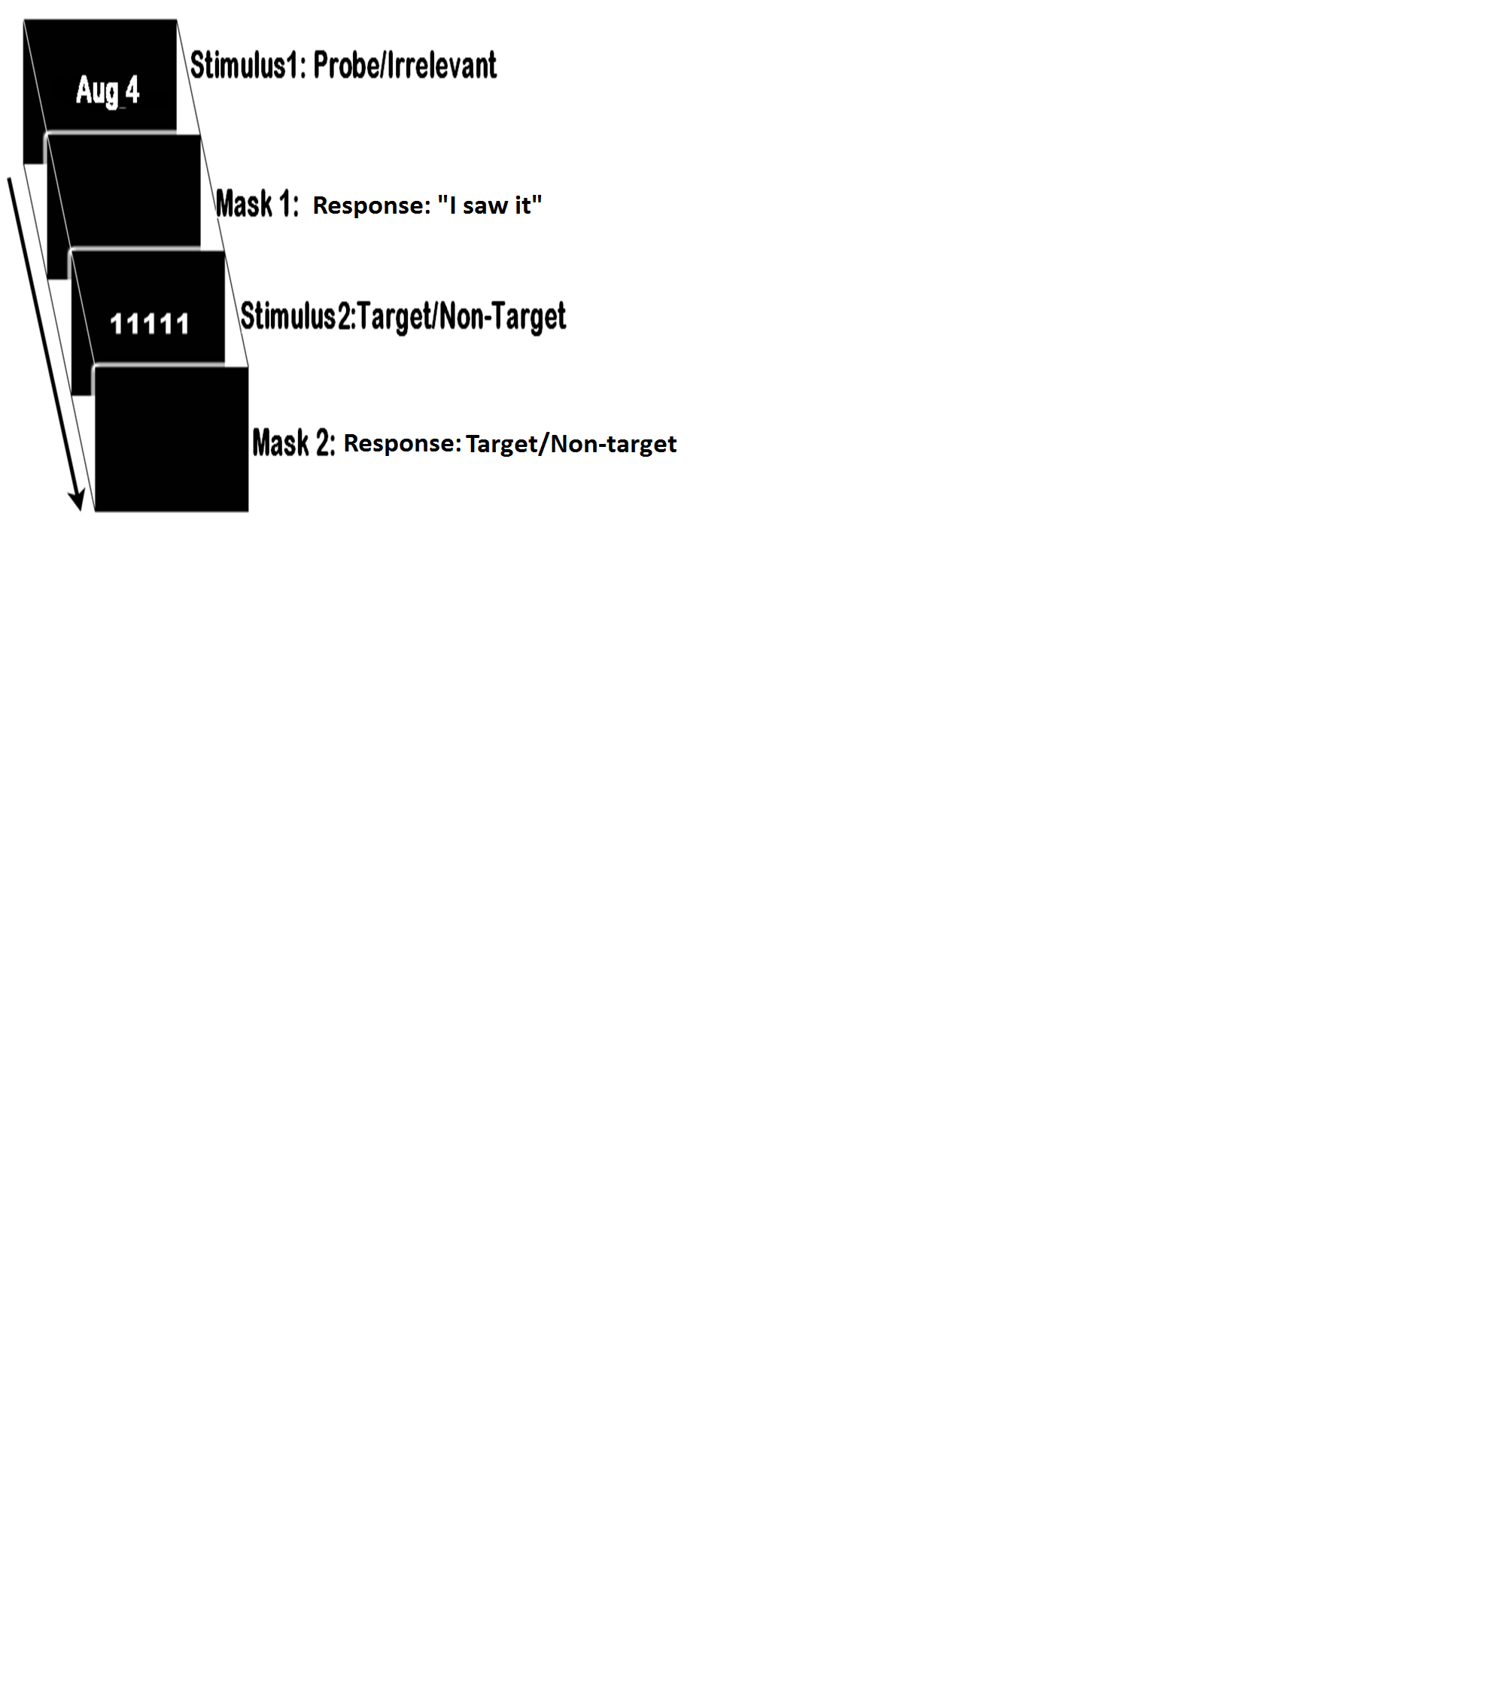

Slide 4
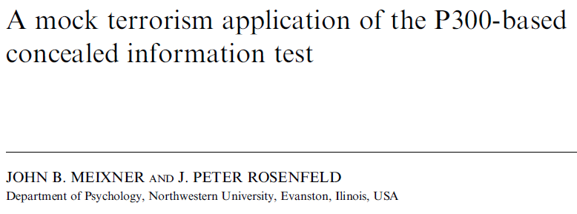
Psychophysiology, 48 (2011), 149–154.

Slide 5
An Innocent Control and Mock Terrorist group
Terrorists read 3 brochures about 1. place, 2.weapons, 3.dates for attack, then make a recommendation to chieftain.
Controls read vacation brochures and recommend to SO’s, parents.
All tested on guilty scenario, 1 block for each category.

Slide 6
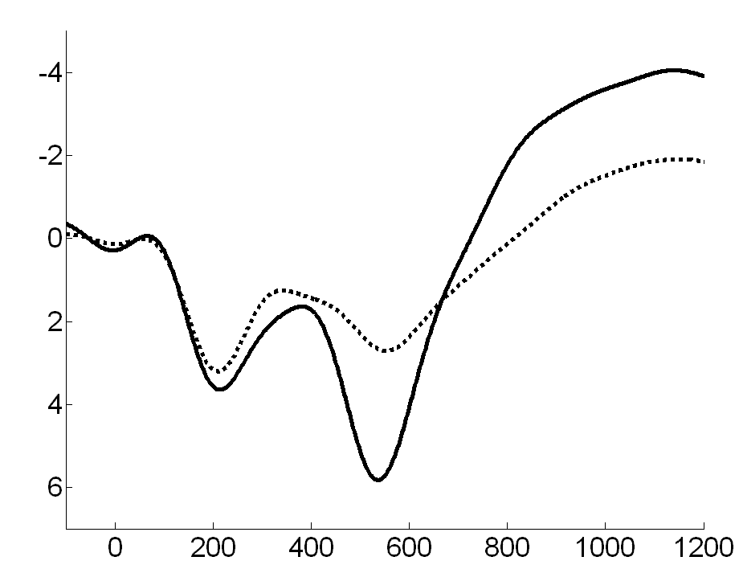
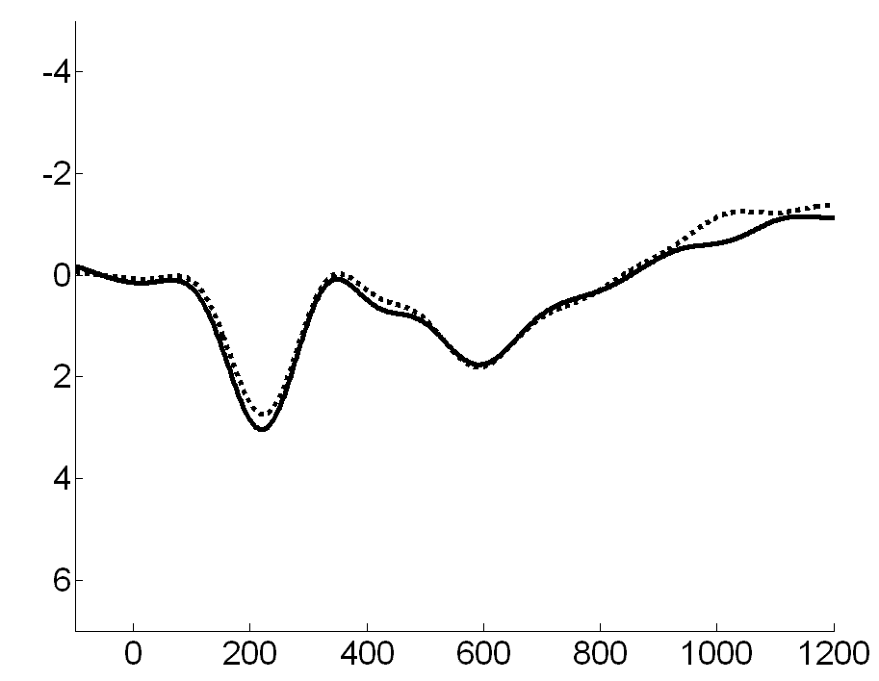

Slide 7
Iall |  | Imax |  | Blind Imax
Guilty | Innocent | Guilty | Innocent | Guilty | Innocent
1000 | 648 | 985 | 287 | 985 | 603
1000 | 610 | 999 | 416 | 998 | 602
955 | 598 | 889 | 476 | 892 | 649
996 | 611 | 898 | 430 | 893 | 605
994 | 150 | 946 | 17 | 943 | 689
909 | 475 | 698 | 284 | 761 | 547
945 | 600 | 677 | 365 | 702 | 536
997 | 555 | 959 | 250 | 961 | 569
999 | 586 | 908 | 217 | 907 | 565
985 | 690 | 888 | 382 | 886 | 706
912 | 390 | 667 | 129 | 698 | 650
903 | 644 | 837 | 215 | 842 | 702
966 | 546 | 863 | 289 | 872 | 619
12/12 | 0/12 | 12/12 | 0/12 | 10/12 | 0/12
AUC = 1.0 |  | AUC = 1.0 |  | AUC = .979

Slide 8
Obviously, I shopped this around some of our intelligence agencies:
A member of the community was not too interested in this test of concealed info detection, but for the needs of his agency was more eager to have a deception detector, ala Pinocchio.
I asked for examples of his agency’s needs, and after awhile, he provided 3 vignettes:

Slide 9
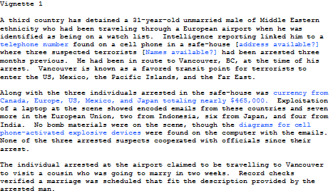

Slide 10
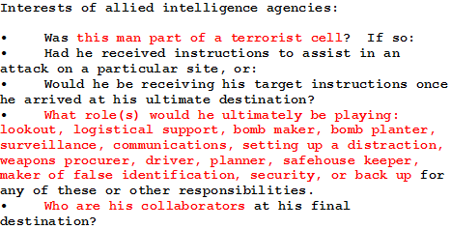

Slide 11
Other Applications of P300-based “Memory Detection” are known…
Forensic, Neuropsychology (Malingering), Various innate preferences….
In recent years we have been looking for ways to increase sensitivity of all, as well as to improve resistance to various countermeasures. Regarding the former……

Slide 12
Part II
Does suspect’s heightened awareness of need to deceive enhance test sensitivity?
Ben-Shakhar et al. asked with ANS-CIT.
Verschuere et al.,(2009) asked question about P300 first with deception vs control group & 3-stimulus protocol: Probe, Target, 4 Irrels., but didn’t get the key interaction: P-I x group, but did get suggestive (p<.08) hit rate difference.
Allen Hu & I re-did study—to try to extend Verschuere et al., ’09.

Slide 13
Verschuere et al. (2009)
1) Verschuere et al. (2009) used an extremely over-learned probe, one’s first name, whose special meaningfulness may have overshadowed the deception manipulation, so that in a control group not alerted about the need to deceive, the oddball effect produced P300 amplitudes at ceiling levels.
2) Subjects were given the deception manipulation only once prior to the P300 recording block. Results: suggestive.

Slide 14
Our New Study
We expected that by maintaining awareness of deception via ongoing feedback throughout the testing run, and use of a less well-rehearsed probe, the home town name, we can demonstrate the enhanced effect of awareness of deception on probe-minus-irrelevant P300 differences and detection rates.

Slide 15
Our Study
Control (low deception awareness) group subjects read, “You are going to see a series of words on the display screen. These words are town names. You are to press the right hand button which means, ‘I recognize the target’ when you see the target name which is Norfolk. You press the left hand button to all other names .
We can tell from your brain waves we record on each trial--with 80-90% accuracy—if you mistakenly press the wrong button. We will give you feedback to this effect every few minutes.”

Slide 16
Deception Group also told: “You are going to see a series of town names…
You are to press the right button which means,’I recognize it’ when you see the target name which is Norfolk. You will therefore be telling the TRUTH since you DO recognize it as your target name. You press the left button which means ‘I don't recognize it’ to all other names which are not targets.
But one of these non-target names you will see is your home town name. When you press the ‘I don't recognize it’ button for this name you will be LYING. You don't recognize it as your target, but you DO recognize it as your home town.
We can tell from your brain waves we record on each trial--with 80-90% accuracy—when you deceptively deny recognizing your personal information. We will give you feedback to this effect every few minutes.”

Slide 17
Deception Feedbacks:
1) “Based on your brain waves in the past several minutes, we see you are lying on certain trials, but mostly following button press instructions very well.”
2) “Based on your brain waves in the past few minutes, we see you are still lying on a few trials, but following button press instructions well.” 3) “Based on your recent brain waves you are lying on certain trials, but mostly following other instructions.” 4)“Based on your brain waves in the past several minutes, we see you are lying on certain trials, but mostly following button press instructions very well.” 5) “Based on your brain waves in the past few minutes, we see you are still lying on a few trials, but following button press instructions very well.” 6)“Based on your recent brain waves you are lying on certain trials, but mostly following other instructions very well.”

Slide 18
Control Feedbacks:
1)“Based on your brain waves in the past few minutes, we see you are making mistaken button presses on certain trials, but mostly following button press instructions very well.”
2) “Based on your brain waves in the past several minutes, we see you are still making a few mistaken button presses on a few trials, but following button press instructions well.” 3) “Based on your recent brain waves, we see you are making some mistaken button presses on certain trials, but mostly following other instructions very well.” 4) “Based on your brain waves in the past few minutes, we see you are still making occasional mistaken button presses on certain trials, but mostly following button press instructions very well.” 5) “Based on your brain waves in the past several minutes, we see you are still making mistaken button presses on a few trials, but following button press instructions well.” 6) “Based on your recent brain waves, we see you are still making a few mistaken button presses on certain trials, but mostly following other instructions very well.”

Slide 19
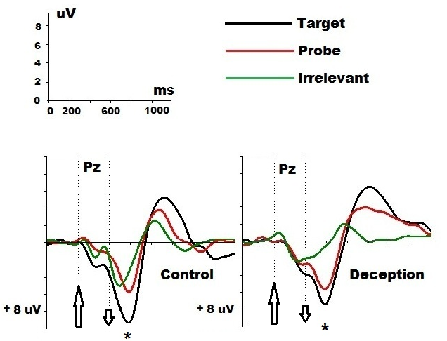

Slide 21
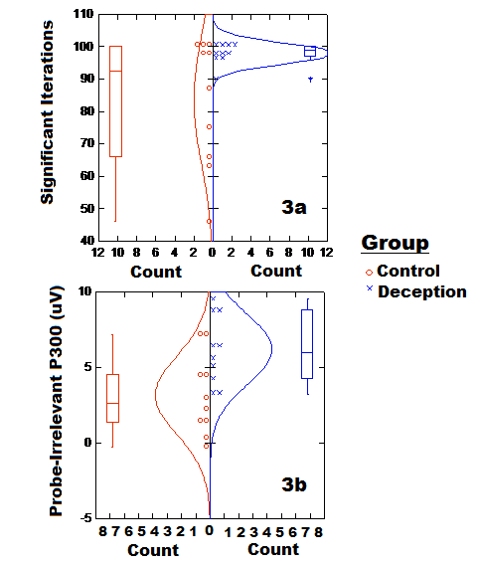

Slide 23
Bottom lines…
Deception awareness enhances sensitivity of 3-stimulus protocol… (used here for comparison with Verschuere et al.)
(Manny Donchin recently reminded me that deception manipulation may work via directing attention to probe category. Could be. We have said that before ourselves.)

Slide 24
Future direction:
Next step: Repeat study with the Complex Trial Protocol, in which we can also certainly alert subjects to try to conceal recognition of crime-relevant information, though they do not lie during test, though they have likely done so in interrogation. They can also get feedback during run, e.g., “you seem to be recognizing some items….”

